Slide 1
189 KENT STREET SYDNEY
CUSTOMISATIONS TRACKER
MARCH 2026

Slide 2
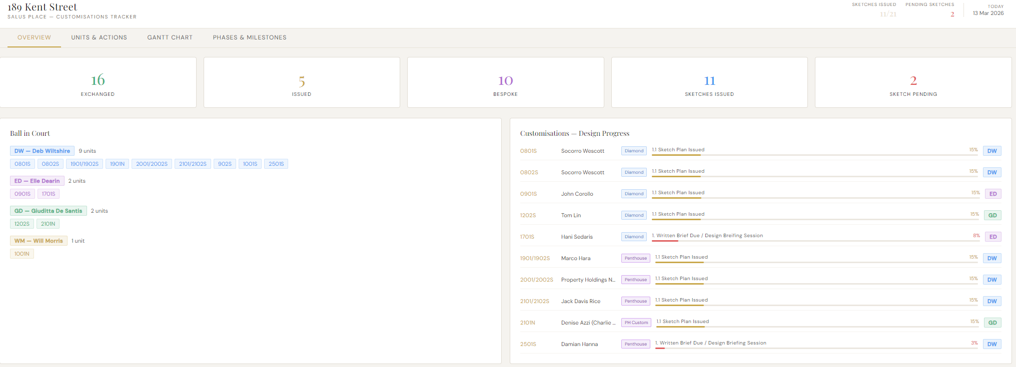
Landing page

Slide 3
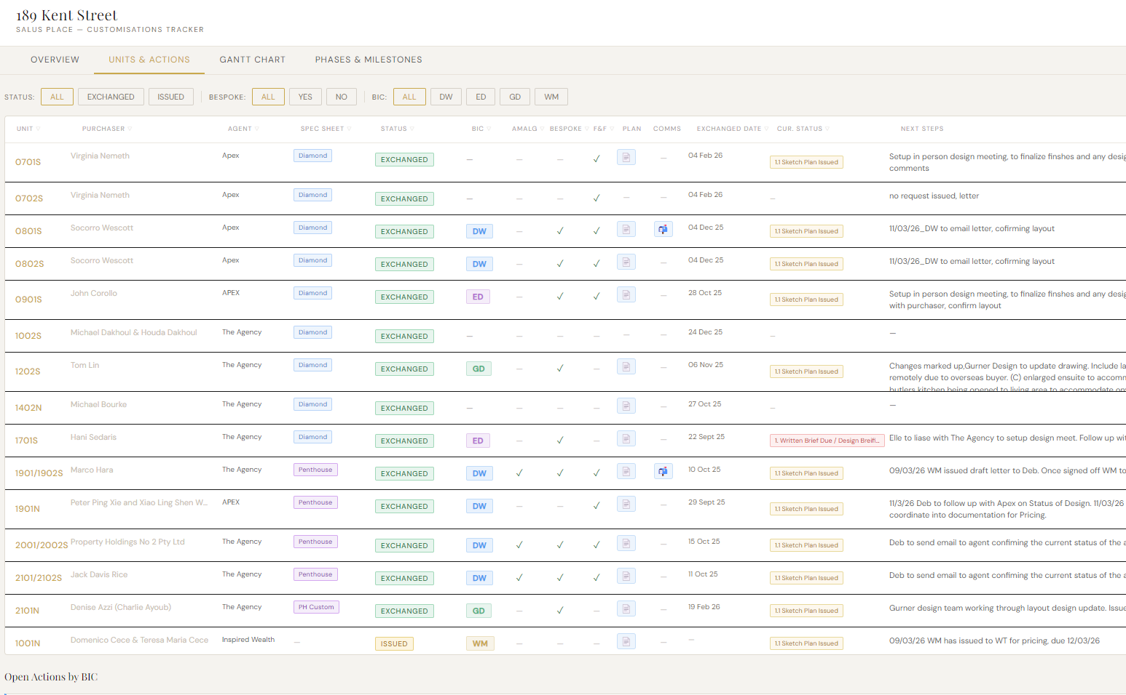
UNITS AND ACTIONS SUMMARY

Slide 4
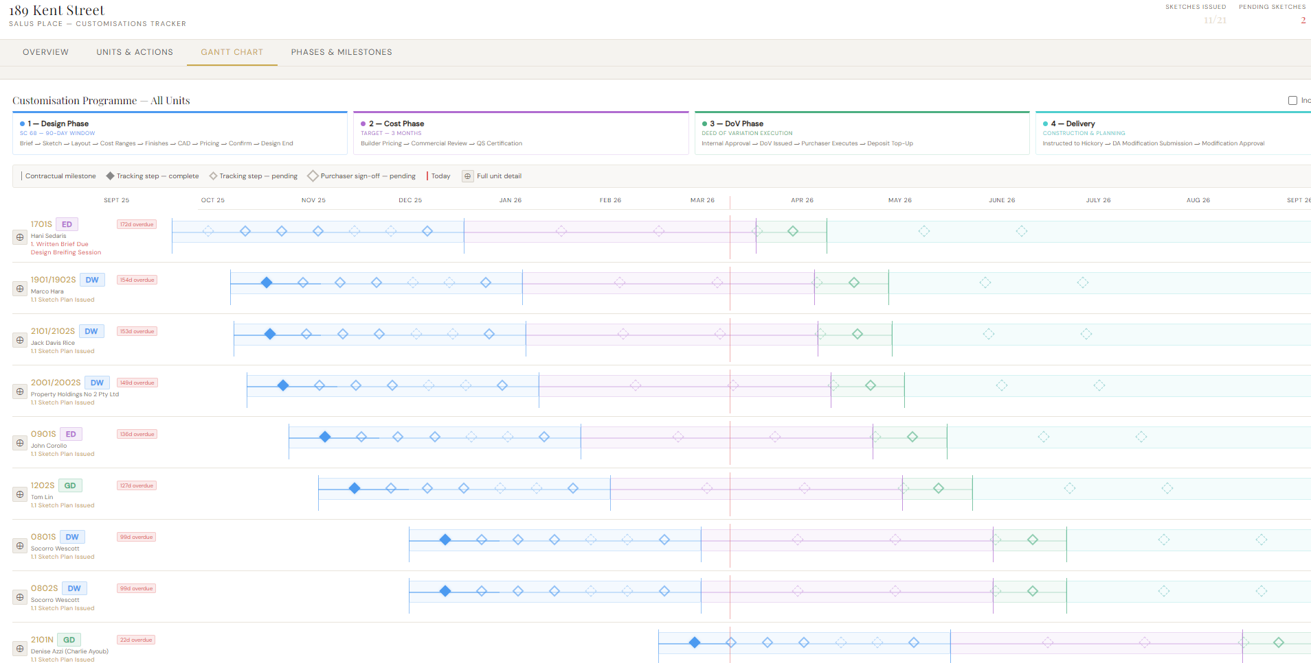
GANTT CHART

Slide 5
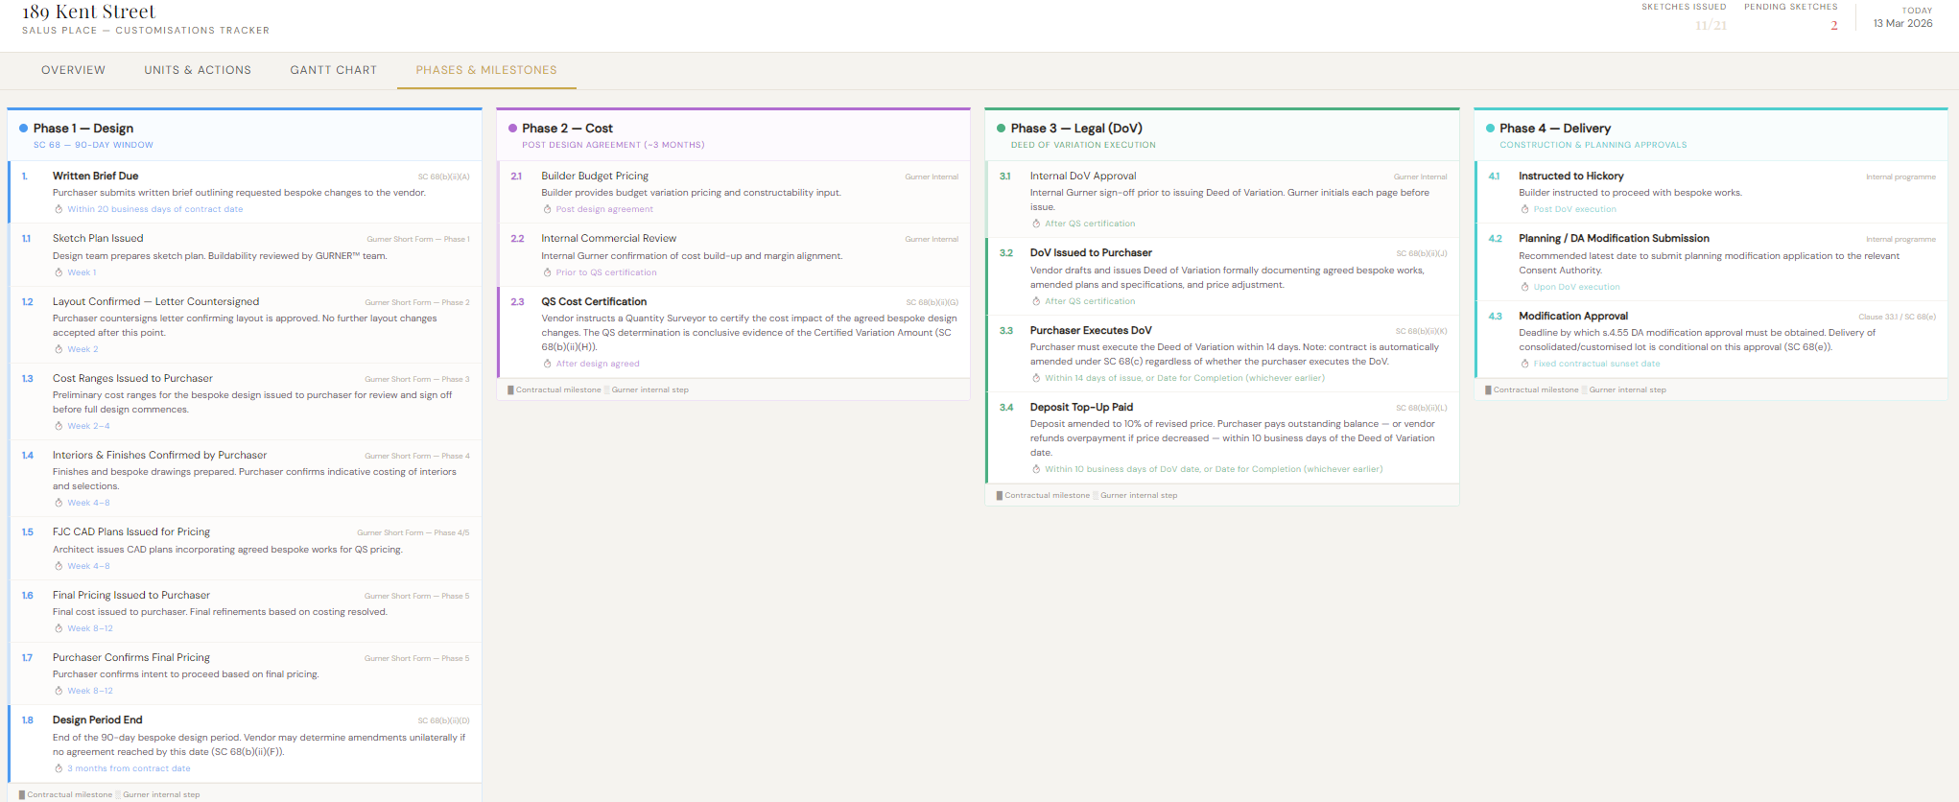
PHASES AND MILESTONES

Slide 6
DASHBOARD LINK
LIVE DASHBOARD LINK – PASSWORD: Kent189
https://gurnerwmorris.github.io/189-Kent_Customisations/

